Slide 1
Lesson 5: Building GUIs in Java with Swing
by Dr. Shafqat Ali Shad

Slide 2
Wholeness of the Lesson
Swing is a windowing toolkit that allows developers to create GUIs that are rich in content and functionality. The ultimate provider of tools for the creation of beautiful and functional content is pure intelligence itself; all creativity arises from this field’s self-interacting dynamics.

Slide 3
Introduction
Sun’s AWT. The original version of Java (jdk1.0) came with a primitive windowing toolkit (the AWT) for making simple GUIs. GUI components were built by using the native GUI toolkit of the target platform (Windows, MacIntosh, Solaris, etc). “Write once, run anywhere” was the goal.
Problems with Peer-Based Approach. The effect of the peer-based approach was that GUI components looked like the GUI elements users of that platform were accustomed to. However, there were problems:
subtle differences in behavior of components like menus and scrollbars on different platforms made it difficult to create a consistent and predictable experience across platforms
in order to support plataforms in which the native GUI toolkit had limited functionality, Sun needed to limit the functionality of its toolkit as well
“write once, debug everywhere” became the slogan

Slide 4
Introduction
IFC. Various alternative windowing toolkits emerged in 1995, 1996, the most significant of which was Netscape’s IFC (Internet Foundation Classes). Components in the IFC toolkit were painted onto blank windows – the native toolkit of the target platform was not used at all. This caused components and their behavior to be identical across all platforms.
Swing. Sun worked with Netscape to refine the peerless IFC approach, producing, in the end, a new windowing toolkit called Swing. Swing was made available (1997) as an extension to jdk1.1, but in the end became part of an enormous upgrade to Java, known as JFC (Java Foundation Classes), which was released as part of jdk1.2 in 1999.
AWT Still Used. Swing components still make use of aspects of the AWT – Swing is built “on top of” the old AWT. In particular, handling of events relies on the old event-handling model.
JavaFX. In 2014, Oracle declared that Swing libraries would be developed no further, and that the windowing toolkit of choice had become JavaFX. JavaFX has more modern-looking components and has a more flexible API. Since Swing is still (as of 2015) far more widely used than JavaFX, Swing is presented here.

Slide 5
Introduction
Industry Standard. For standalone GUI development in Java, Swing is the toolkit most often used. A “runner up” is SWT, the toolkit that Eclipse was built from; it is available as an Eclipse plug-in.
Visual Designers. Visual Basic, C++ and C# provide excellent tools for tool-aided drag-and-drop creation of GUIs, and even automatic GUI generation. Such tools have also appeared in the Java world. Symantec’s Visual Café, IBM’s Visual Age for Java, Borland’s JBuilder, Sun’s Visual Designer, and NetBeans’ Matisse – all have offered their own versions of visual designers. Many experts in the field feel that these are good for prototyping but not for industry-strength GUIs, since the generated code is hard to maintain (but there are enthusiasts who disagree). It is also generally accepted that learning the principles of good GUI design, and the implementation of those principles in the Java language, are pre-requisites for effective use of such tools. A visual tool called SceneBuilder comes with JavaFX and makes it easier than ever to create UIs without coding, but still, to understand it is important to understand what is going on instead of just relying on a tool.

Slide 6
Introduction
About This Lesson. This is a quick introduction to
Using Swing components and containers
Layout basics
Handling GUI events
Swing has many features, but this lesson is enough to allow you to build simple but attractive and functional GUIs for your own applications.

Slide 7
Main Idea in Swing
Components and containers. Swing provides components (like text boxes, buttons, checkboxes) and containers (frames, windows, panels, applets) in which such components can be placed.
Containers placed in other containers. In Swing, a container is also considered to be another kind of component, so containers can be placed in other containers.
LayoutManagers for containers. Every container supports the use of a layout strategy. To achieve the visual objectives in building Swing screens requires skillful use of layouts on multiple containers.
Listeners = Event Handlers. A Swing GUI becomes responsive to user actions (like button presses, item selections, etc) by means of an event handling model. In this model, there are “listeners” for user actions (like button presses and mouse clicks). When a relevant user action occurs, the listener is informed and the code that you have written to handle the event will then be executed.

Slide 8
JFrames
The top-level container class in Swing is JFrame. (“Top-level” means “not contained in any other containers.”) JFrame is equipped with a title bar whose value can be modified. class MyFrame extends JFrame {
MyFrame() {
setTitle(″Hello World″);
}

Slide 9
JFrames
To see the result so far, create an instance of MyFrame and call the setVisible method on it. Because of the non-threadsafe nature of Swing components, all component-building (to be safe) must be done through the EventQueue, so we have to create our JFrame and make it visible with the following mysterious code, which places our GUI-building thread in Swing’s event queue, where it will be executed in the proper order. public static void main(String[] args) { EventQueue.invokeLater(new Runnable()
{
public void run() {
MyFrame1 mf = new MyFrame1();
mf.setVisible(true);
}
});
}

Slide 10
JFrames
Need to adjust size and position.
public class MyFrame extends JFrame {
public MyFrame(){
setDefaultCloseOperation(JFrame.EXIT_ON_CLOSE);
setTitle("Hello World");
setSize(320,240); //see NOTE below
centerFrameOnDesktop(this);
setResizable(false);
}
public static void centerFrameOnDesktop(Component f) {
Toolkit toolkit = Toolkit.getDefaultToolkit();
int height = toolkit.getScreenSize().height;
int width = toolkit.getScreenSize().width;
int frameHeight = f.getSize().height;
int frameWidth = f.getSize().width;
f.setLocation(((width-frameWidth)/2),
(height-frameHeight)/3);
}
}

Slide 11
JFrame
NOTE: Once you have added your components to your JFrame (see below), a more elegant way of declaring the size of the window is by calling the JFrame method pack() – this method will make the window just large enough to fit in all the components. However, pack() should be called only after all components have been added. Also, centering window on the desktop should be done after size has been set (either with setSize() or pack()) – otherwise the centering effect will be destroyed when a new size is introduced.

Slide 12
Adding Components
Typically, you will organize components into various containers (called “panels”) and assemble the panels into the main frame. For consistency, it is helpful to create a “top-level” panel that will contain all the other panels that you define.
You can add components to your main panel, but they will be arranged according to a default layout (called FlowLayout). (Note: The default layout for the content pane of a JFrame is BorderLayout.)

Slide 13
Adding Components
//make the text field and label instance variables in MyFrame
JTextField text;
JLabel label;
public MyFrame(){
//put initializations like setSize, setTitle, centerFrame here
initializeWindow();
JPanel mainPanel = new JPanel();
text = new JTextField(10);
label = new JLabel("My Text");
JButton button = new JButton("My Button");
mainPanel.add(text);
mainPanel.add(label);
mainPanel.add(button);
getContentPane().add(mainPanel);
}

Slide 14
MAIN POINT
Swing classes are of two kinds: components and containers. A screen is created by creating components (like buttons, textfields, labels) and arranging them in one or more containers. Components and containers are analgous to the manifest and unmanifest fields of life; manifest existence, in the form of individual expressions, lives and moves within the unbounded container of pure existence.

Slide 15
Layout Managers: FlowLayout and BorderLayout
A Layout Manager is a Java class that decides how components will be arranged in a container and to what extent the preferred size of these components will be honored.
The preferred size of a component, is, roughly, the minimum size it can have and still be visually meaningful (for example, a button's preferred size is "just big enough" so that you can see the button's label)
The general rule is that the components in a container will be given their preferred size unless the policy of the container's layout manager conflicts with this

Slide 16
Layout Managers: FlowLayout and BorderLayout
FlowLayout has the following simple policy:
All components are given their preferred size
When components are added to the container, they are added from left to right in horizontal rows; when a row is filled up, components are placed in a new line below the first
The default distance between successive components (both horizontally and vertically) is 5 pixels – this quantity can be modified
The entire cluster of components in a row can be justified left, justified right, or centered using these arguments, respectively, in the FlowLayout constructor: FlowLayout.LEFT, FlowLayout.RIGHT, FlowLayout.CENTER

Slide 17
Layout Managers: FlowLayout and BorderLayout
BorderLayout policy:When components are added, they are placed in one of 5 regions in the container, specified by BorderLayout.NORTH, BorderLayout.SOUTH, BorderLayout.EAST, BorderLayout.WEST, BorderLayout.CENTER
If no region is specified, CENTER is the default. It is not necessary to populate every region with a component.
The preferred height of components placed North or South is honored, but the width of such components is made to be as wide as the container itself

Slide 18
Layout Managers: FlowLayout and BorderLayout
The preferred width of components placed East or West is honored. The height of such a component is forced to extend to the top and bottom of the container unless a component occupies North or South position. If North is occupied, then the height of West (and East) extends up to the North component. If South is occupied, the height of West (and East) extends down to the South component.
A component that occupies the Center position is stretched to fill out the region up to the components in the other positions.
The gaps between these regions is, as with FlowLayout, 5 pixels both vertically and horizontally.

Slide 19
MAIN POINT
Components are arranged in a container through the use of layout managers that organize components in different ways. FlowLayout preserves the size of components and lays components out horizontally, from left to right. BorderLayout lays out components in five positions – north, south, east, west and center; to preserve the size of components, BorderLayout is used in conjunction with FlowLayout. Likewise, all of manifest life is conducted by a vast network of natural laws.

Slide 20
Applying Layout Managers
JTextField and JLabel. Returning to our example, if we wish to left justify our text field and label, placing the label below the text field (as in many GUIs), we can create the following panels:
a textPanel that will have a BorderLayout, so we can arrange the text field and label vertically
a topTextPanel that will allow us to control the position of the text field – we can specify that the text field should be placed at the far left of this panel, using a FlowLayout
a bottomTextPanel that will allow us to control the position of the label – again we use a FlowLayout
place the topTextPanel in the NORTH position and bottomTextPanel in the CENTER position of the textPanel.

Slide 21
Applying Layout Managers
JTextField and JLabel. Returning to our example, if we wish to left justify our text field and label, placing the label below the text field (as in many GUIs), we can create the following panels:
a textPanel that will have a BorderLayout, so we can arrange the text field and label vertically
a topTextPanel that will allow us to control the position of the text field – we can specify that the text field should be placed at the far left of this panel, using a FlowLayout
a bottomTextPanel that will allow us to control the position of the label – again we use a FlowLayout
place the topTextPanel in the NORTH position and bottomTextPanel in the CENTER position of the textPanel.

Slide 22

Applying Layout Managers
JPanel topText = new JPanel();
JPanel bottomText = new JPanel();
topText.setLayout(new FlowLayout(FlowLayout.LEFT,5,0));
bottomText.setLayout(new FlowLayout(FlowLayout.LEFT,5,0));
text = new JTextField(10);
label = new JLabel("My Text");
label.setFont(makeSmallFont(label.getFont()));
topText.add(text);
bottomText.add(label);
textPanel = new JPanel();
textPanel.setLayout(new BorderLayout());
textPanel.add(topText,BorderLayout.NORTH);
textPanel.add(bottomText,BorderLayout.CENTER);

Slide 23
Applying Layout Managers
Layout of the textfield/label combination and the Button. Now suppose we wish to place the textfield/label component we created in the upper left of the screen and place the button in the middle of the screen. We can create the following panels:
a topPanel to hold the textfield/label – use a FlowLayout to left-justify
a middlePanel to hold the button – use a FlowLayout to center the button
layout the mainPanel with BorderLayout, and place topPanel in the NORTH and middlePanel in the CENTER.

Slide 24
Applying Layout Managers
Layout of the textfield/label combination and the Button. Now suppose we wish to place the textfield/label component we created in the upper left of the screen and place the button in the middle of the screen. We can create the following panels:
a topPanel to hold the textfield/label – use a FlowLayout to left-justify
a middlePanel to hold the button – use a FlowLayout to center the button
layout the mainPanel with BorderLayout, and place topPanel in the NORTH and middlePanel in the CENTER.

Slide 25
Applying Layout Managers
public MyFrame(){
initializeWindow();
JPanel mainPanel = new JPanel();
defineTopPanel();
defineMiddlePanel();
mainPanel.setLayout(new BorderLayout());
mainPanel.add(topPanel, BorderLayout.NORTH);
mainPanel.add(middlePanel, BorderLayout.CENTER);
getContentPane().add(mainPanel);
}
private void defineTopPanel() {
topPanel = new JPanel();
defineTextPanel();
topPanel.setLayout(new FlowLayout(FlowLayout.LEFT));
topPanel.add(textPanel);
}
private void defineMiddlePanel(){
middlePanel=new JPanel();
middlePanel.setLayout(new FlowLayout(FlowLayout.CENTER));
button = new JButton("My Button");
middlePanel.add(button);
}

Slide 26
MAIN POINT
Because containers are themselves a certain type of component, containers can be organized inside of other containers. Attractive visual design of GUIs is accomplished in Swing through the creative use of multiple layouts of container classes. The natural order of existence is created and maintained by the hidden dynamics of pure intelligence.

Slide 27
Handling Events
So far, when we click the button on our GUI, there is no GUI response. To get something to happen, we associate a “listener” to the button; the listener will be informed (by way of an ActionEvent) whenever the button is clicked at runtime.
Here is a slightly more detailed overview of event handling in the AWT:
A listener object is an instance of a class that implements a listener interface – typical example: ActionListener -- used for the most common GUI components in Java. (An interface in Java is like a Java class except that it simply lists method signatures and return types without implementation. More about interfaces in Lesson 6.) Here is ActionListener from the source code for the Java libraries:
public interface ActionListener {
public void actionPerformed(ActionEvent e);
}
When a class implements an interface, it means that the class provides an implementation for each of the method declared in the interface.
Note: Interfaces are discussed in detail in Lesson 7.

Slide 28
Handling Events
An event source is an object that can register listener objects and send them event objects – examples: buttons, menu items, checkboxes, combo boxes
The event source sends out event objects to all registered listeners when that event occurs – for instance, when a button is clicked, all listeners for this button receive an ActionEvent instance
Listener objects use the information in the event object received to determine their reaction to the event

Slide 29
Handling Events
Example. For our GUI example, we now register an ActionListener – named MyButtonListener – when we define our button. We specify the response to a button click in the body of the actionPerformed method.

Slide 30
Handling Events
//define the listener class
public class MyButtonListener implements ActionListener {
//the text field we are listening to
private JTextField text;
public MyButtonListener(JTextField text) {
this.text = text;
}
public void actionPerformed(ActionEvent evt){
String textVal = text.getText();
final String prompt = "Type a string";
final String youWrote = "You wrote: ";
if(textVal.equals("") ||
textVal.equals(prompt) ||
textVal.startsWith(youWrote)){
text.setText(prompt);
}
else {
text.setText(youWrote+"\""+textVal+"\".");
}
}
}

Slide 31
Handling Events
//Inside MyFrame, register your new
//listener class when the button is defined
button = new JButton("My Button");
//because our text field is stored as an instance variable
//we can pass it in to the listener like this:
button.addActionListener(new MyButtonListener(text));

Slide 32
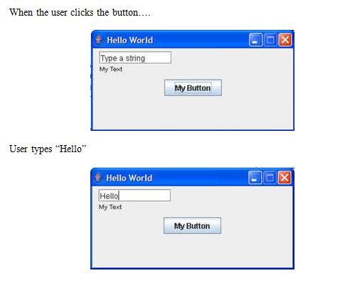
Handling Events

Slide 33
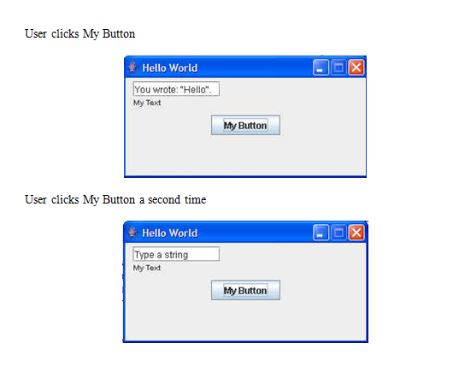
Handling Events

Slide 34
Brief Introduction to Inner Classes: Listeners As Inner Classes
Notice that the class MyButtonListener is closely associated with MyFrame – it relies on the text field of MyFrame and has behavior that is customized to the requirements of this particular application.
It is therefore natural to think of MyButtonListener as an auxiliary class for the private use of MyFrame.
Java supports this need with inner classes – an inner class is (roughly speaking) a class that is defined within another class. The resulting inner class has access to all the instance variables of its surrounding class.
If we make MyButtonListener an inner class of MyFrame, then there is no longer a need to pass a text field into the listener class since it will automatically have access to it.

Slide 35
Brief Introduction to Inner Classes: Listeners As Inner Classes
public class MyFrame extends JFrame {
private JTextField text;
private JLabel label;
private JButton button;
public MyFrame() {
// . . .
}
private void defineMiddlePanel(){
middlePanel=new JPanel(); // . . .
button = new JButton("My Button");
button.addActionListener(new MyButtonListener());
// . . .
}

Slide 36
Brief Introduction to Inner Classes: Listeners As Inner Classes
// . . .
//now defined as an innner class
class MyButtonListener implements ActionListener {
public void actionPerformed(ActionEvent evt){
//automatic access to MyFrame’s instance variables
String textVal = text.getText();
final String prompt = "Type a string";
final String youWrote = "You wrote: ";
if(textVal.equals("") ||
textVal.equals(prompt) ||
textVal.startsWith(youWrote)){
text.setText(prompt);
}
else if(textVal.equalsIgnoreCase("error")){
showMessage("An error has occurred!");
text.setText(prompt);
}
else {
text.setText(youWrote+"\""+textVal+"\".");
}
}
}
}

Slide 37
MAIN POINT
A GUI becomes responsive to user interaction (for example, button clicks and mouse clicks) through Swing’s event-handling model in which event sources are associated with listener classes, whose actionPerformed method is called (and is passed an event object) whenever a relevant action occurs. To make use of this event-handling model, the developer defines a listener class, implements actionPerformed, and, when defining an event source (like a button), registers the listener class with this event source component. The “observer” pattern that is used in Swing mirrors the fact that in creation, the influence of every action is felt everywhere; existence is a field of infinite correlation; every behavior is “listented to” throughout creation.

Slide 38
Displaying Pop-up Messages
The Swing class JOptionPane makes it easy to pop up a standard dialog box that prompts users for a value or informs them of something (such as error messages). See the Java API docs for all the different options in using this class. We focus on one common usage here:
Example: In our example, we will add one more piece of functionality. When the user types in the word “error” in the text box, the GUI will respond by displaying a popup with an error message:

Slide 39
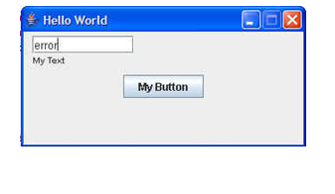
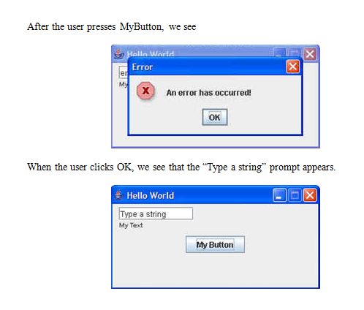
Displaying Pop-up Messages

Slide 40
Displaying Pop-up Messages
To achieve this behavior, we modify the listener code to check for the input “error” like this:
class MyButtonListener implements ActionListener {
public void actionPerformed(ActionEvent evt){
String textVal = text.getText();
final String prompt = "Type a string";
final String youWrote = "You wrote: ";
if(textVal.equals("") ||
textVal.equals(prompt) ||
textVal.startsWith(youWrote)){
text.setText(prompt);
}
else if(textVal.equalsIgnoreCase("error")){
showMessage("An error has occurred!");
text.setText(prompt);
}
else {
text.setText(youWrote+"\""+textVal+"\".");
}
}
}

Slide 41
The work of displaying the message is encapsulated in the showMessage() method:
private void showMessage(String message){
JOptionPane.showMessageDialog(this,
message,
"Error",
JOptionPane.ERROR_MESSAGE);
}

Slide 42
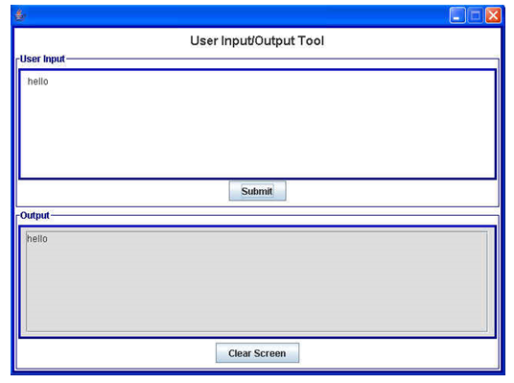
The UserIO GUI
The class UserIO is a simple GUI that we will use in class for some of the labs. It makes use of the principles described here, uses some additional techniques, and is well suited for displaying input/output behavior. See package lesson5.useriogui

Slide 43
CONNECTING THE PARTS OF KNOWLEDGE WITH THE WHOLENESS OF KNOWLEDGE
The self-referral dynamics arising from the reflexive association of container classes
In Swing, components are placed and arranged in container classes for attractive display.
In Swing, containers are also considered to be components; this makes it possible to place and arrange container classes inside other container classes. These self-referral dyanmics support a much broader range of possibilities in the design of GUIs.

Slide 44
Thank you

